Slide 1
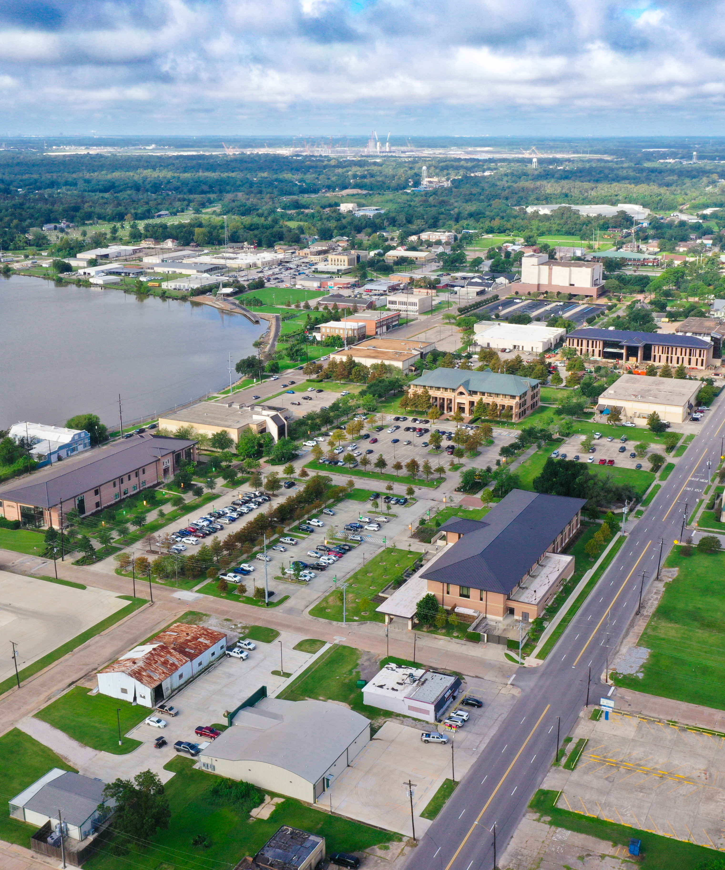

Presentation
Title
[Subtitle or Presenter Name]
[Date] | [Department or Event]
lsco.edu | Orange, TX

Slide 2
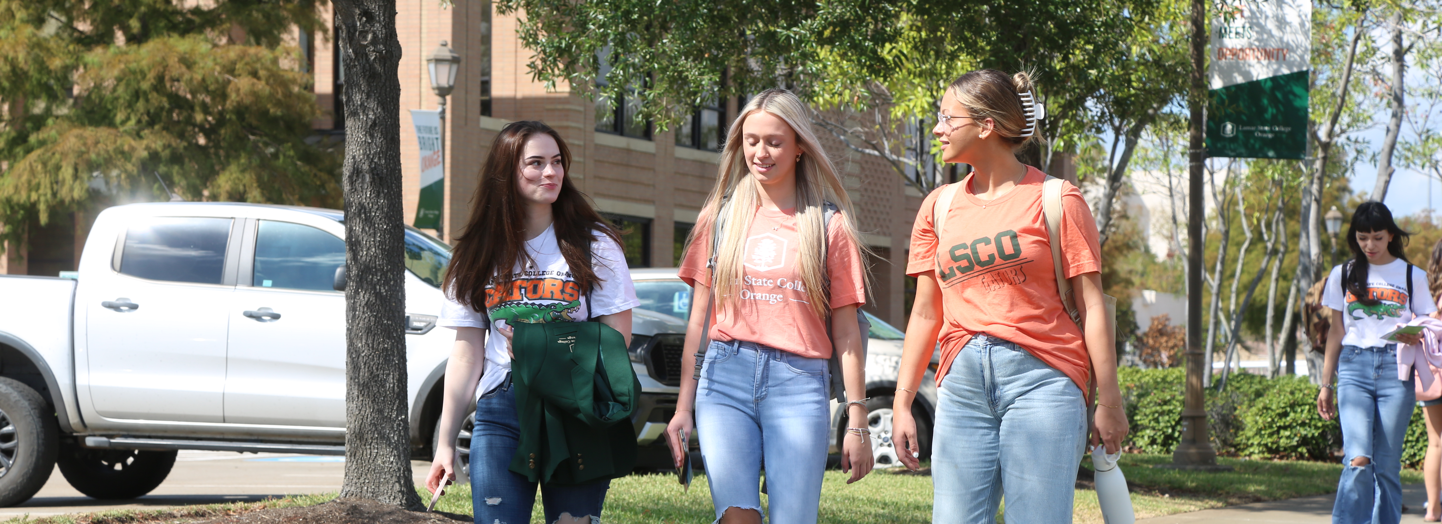
ABOUT
LSCO
Our Mission
Lamar State College Orange transforms lives and communities through the continual pursuit of academic, professional, and personal excellence.
We provide new and unique opportunities for growth and success.
~5,800
55+
33+
Orange, Texas
Texas State University System
Member Institution
Students Enrolled
Years Serving SE Texas
New Programs Since 2020
[ Insert Campus Photo ]
Est. 1969
Lamar State College Orange | lsco.edu

Slide 3
LSCO At a Glance
Affordable Education
Small Class Sizes
LSCO offers some of the most affordable tuition in Texas, ensuring access to quality higher education for all students.
Personalized instruction means students are known by name. Advisors and faculty are deeply invested in student success.
Diverse Programs
Transfer & Workforce Ready
AA, AS, and AAS degrees plus certificates in business, health, technology, arts, and more. 33+ programs added since 2020.
Coursework transfers to four-year institutions. Programs also prepare graduates to enter the workforce directly.
Lamar State College Orange | lsco.edu

Slide 4
Programs & Career Pathways
Pathways that lead to associate degrees and certificates that transfer or launch careers.
Arts & Humanities
Business
Public Service
Communication, Liberal Arts, Sociology
Accounting, Management, Finance
Hospitality, Education, Criminal Justice
Health Professions
STEM
Trades & Industry
Nursing, Allied Health, Dental Assisting
Computer Science, Math, Natural Science
Electromechanical, Maritime, Process Tech
Lamar State College Orange | lsco.edu

Slide 5
Section
Title
LAMAR STATE COLLEGE ORANGE
[ Insert Section Photo ]
[Optional subtitle]
[Optional Description]
lsco.edu

Slide 6
Slide Title
[Content Header]
[ Insert Supporting Photo ]
Key point or topic one
Key point or topic two
Key point or topic three
Key point or topic four
Lamar State College Orange | lsco.edu
[Slide subtitle or date]

Slide 7
Slide Title
[ Insert Supporting Photo ]
[Content Header]
[Add your content, description, data, or supporting details here. This column is fully editable and will accommodate up to several lines of text or bullet points.]
Lamar State College Orange | lsco.edu
[Slide subtitle or date]

Slide 8
Slide Title
[Optional introductory sentence or context for this slide.]
First key bullet point or topic sentence for this section.
Supporting detail or elaboration on the first point above.
Second key bullet point or topic sentence for this section.
Supporting detail or elaboration on the second point above.
Third key bullet point or topic sentence for this section.
Supporting detail or elaboration on the third point above.
Lamar State College Orange | lsco.edu

Slide 9
Photo Gallery Title
[ Insert Photo 1 ]
[ Insert Photo 2 ]
[ Insert Photo 3 ]
[Caption or description for photo 1]
[Caption or description for photo 2]
[Caption or description for photo 3]
Lamar State College Orange | lsco.edu

Slide 10

Thank You
Go Gators!
[Presenter Name] | [Title] | [Email]
lsco.edu • Orange, Texas • Member the Texas State University System

